Slide 1
Quiz Management System
A console-based application to manage quizzes using Python and MySQL

Slide 2
Introduction
This application allows users to create, view, update, delete, search, and export quizzes. It supports multiple-choice questions and stores all data in a MySQL database.

Slide 3

Technologies Used
Programming Language: Python
Database: MySQL
Libraries: pymysql for database connectivity csv for exporting quiz data
Interface: Console-based CLI

Slide 4
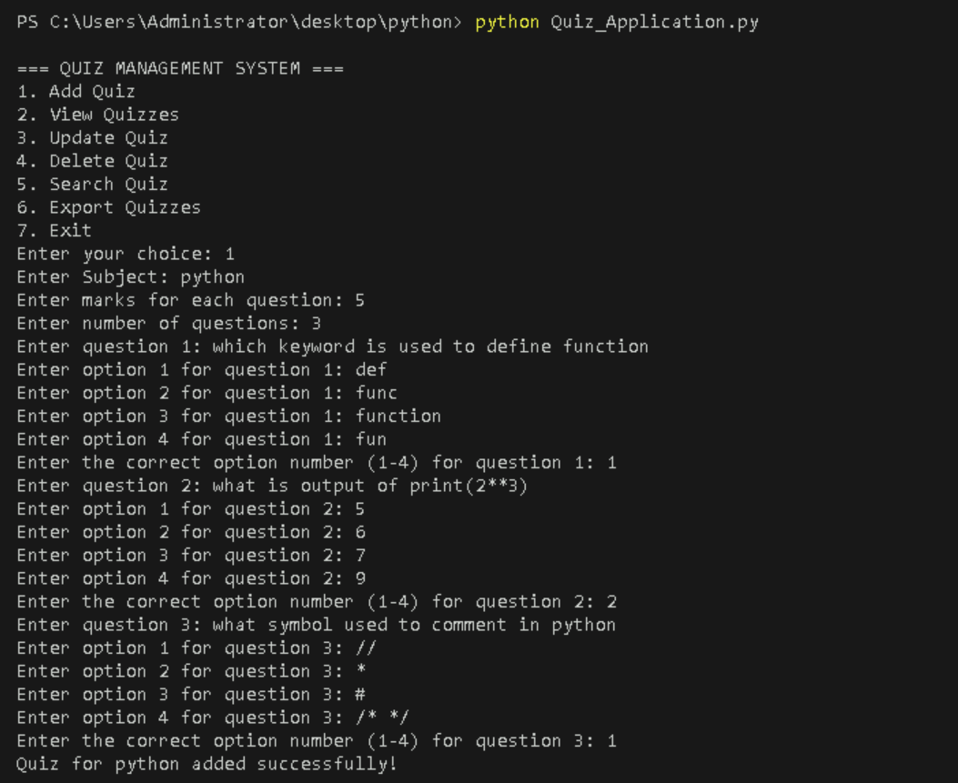
Add Quiz
Functionality:
Enter subject, marks per question, and number of questions
Input each question with four options and correct answer
Data is stored in quizzes and questions tables

Slide 5
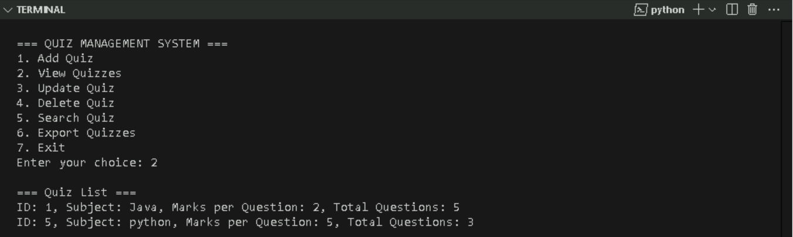
View Quizzes
Functionality:
Displays all quizzes from the database
Shows quiz ID, subject, marks per question, and total questions

Slide 6
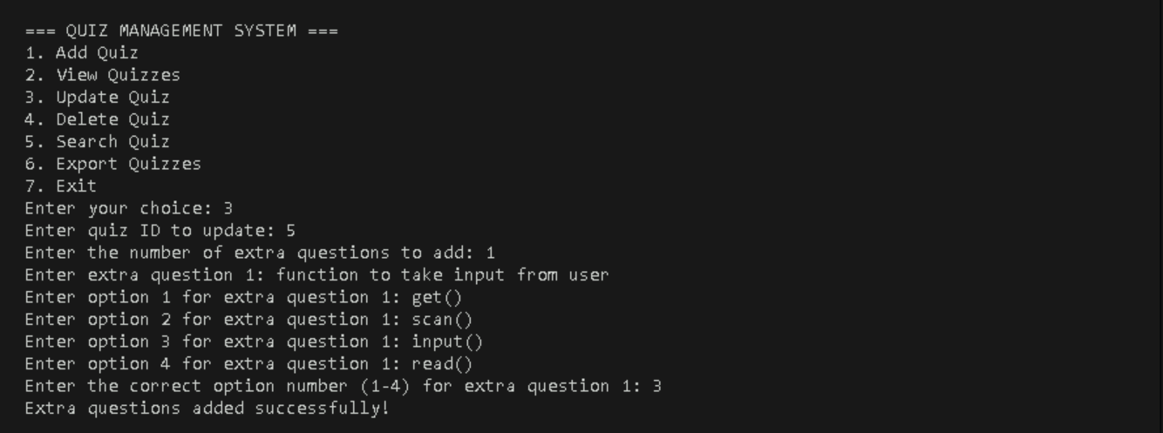
Update Quiz
Functionality:
Select quiz by ID
Add extra questions to an existing quiz
Each question includes options and correct answer

Slide 7
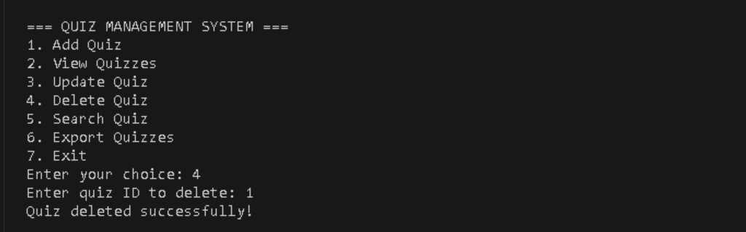
Delete Quiz
Functionality:
Delete quiz by ID
Removes both quiz and its associated questions from the database
Screenshot Placeholder: Add screenshot of delete confirmation

Slide 8
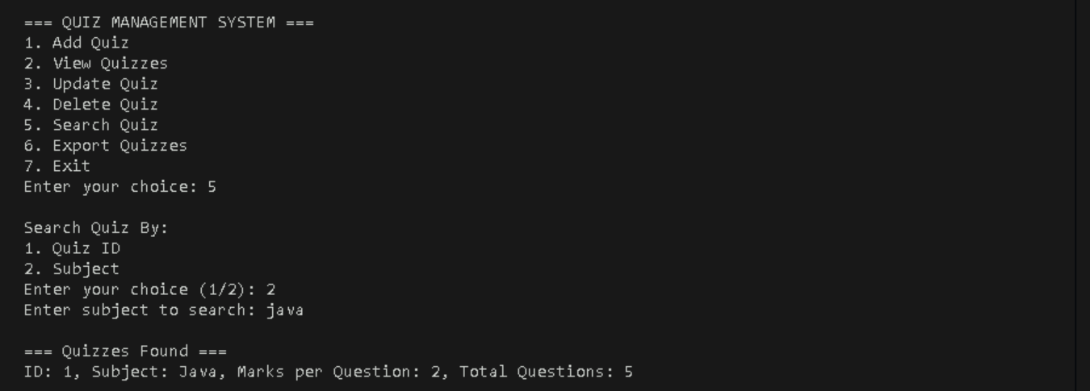
Search Quizz
Functionality:
Search by quiz ID or subject
Displays quiz details and all associated questions
Screenshot Placeholder: Add screenshot of search results

Slide 9
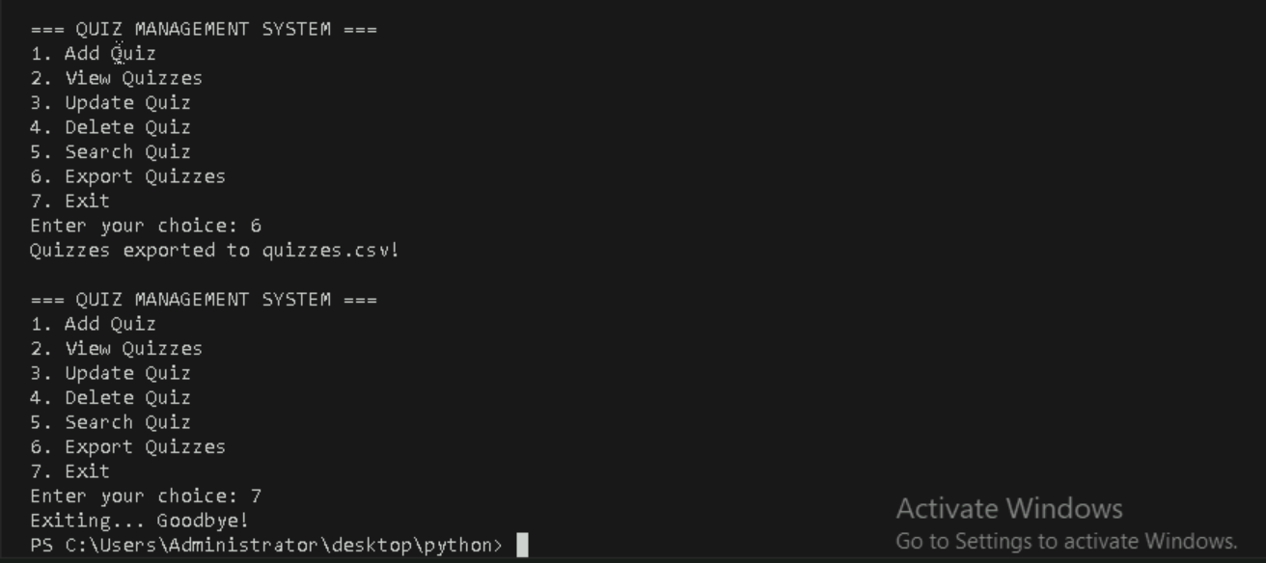
Export Quiz
Functionality:
Search by quiz ID or subject
Displays quiz details and all associated questions

Slide 10
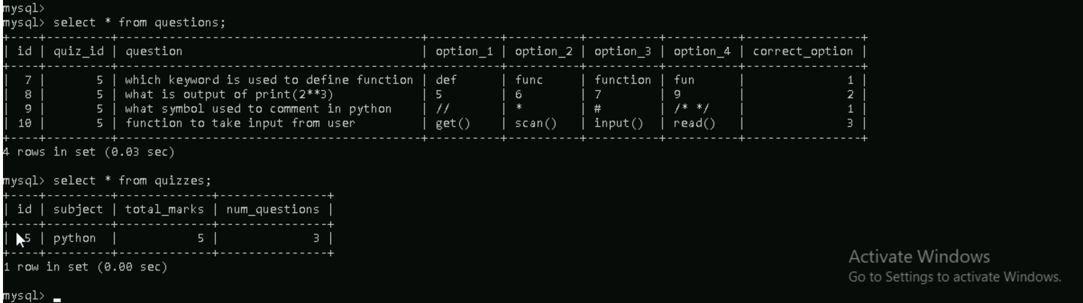
Database Overview
Functionality:
Tables Used:
quizzes: Stores quiz metadata
questions: Stores individual questions linked to quizzes

